Slide 1

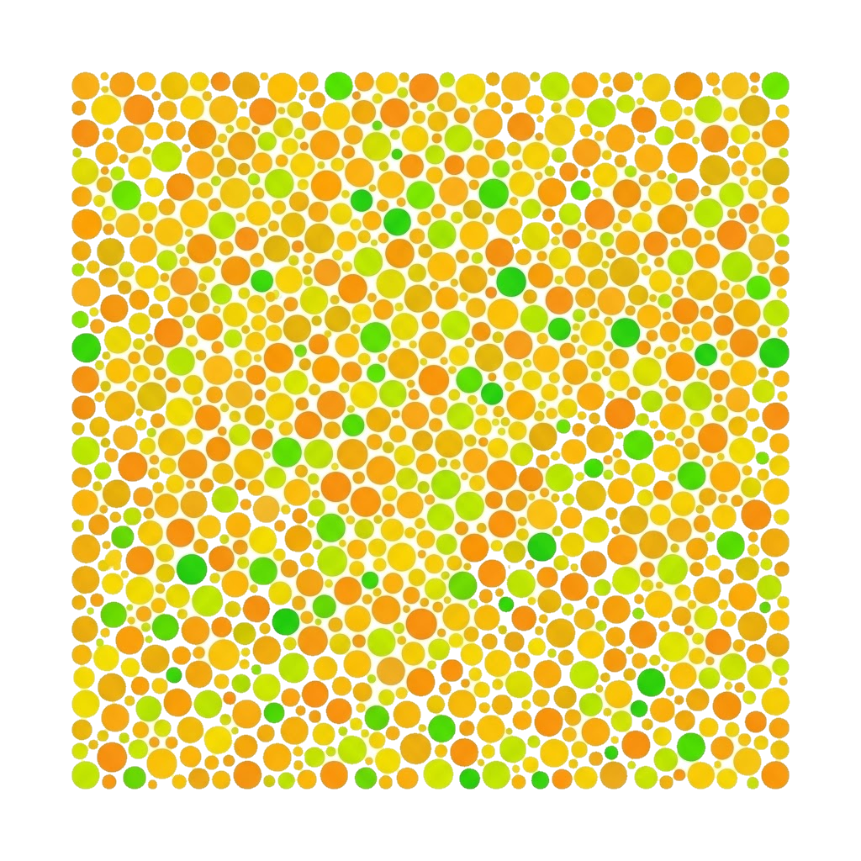
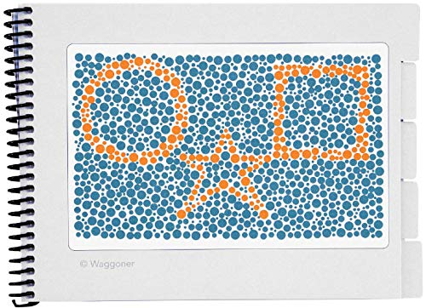
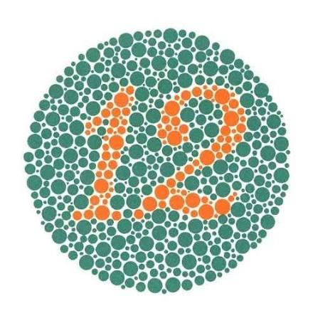
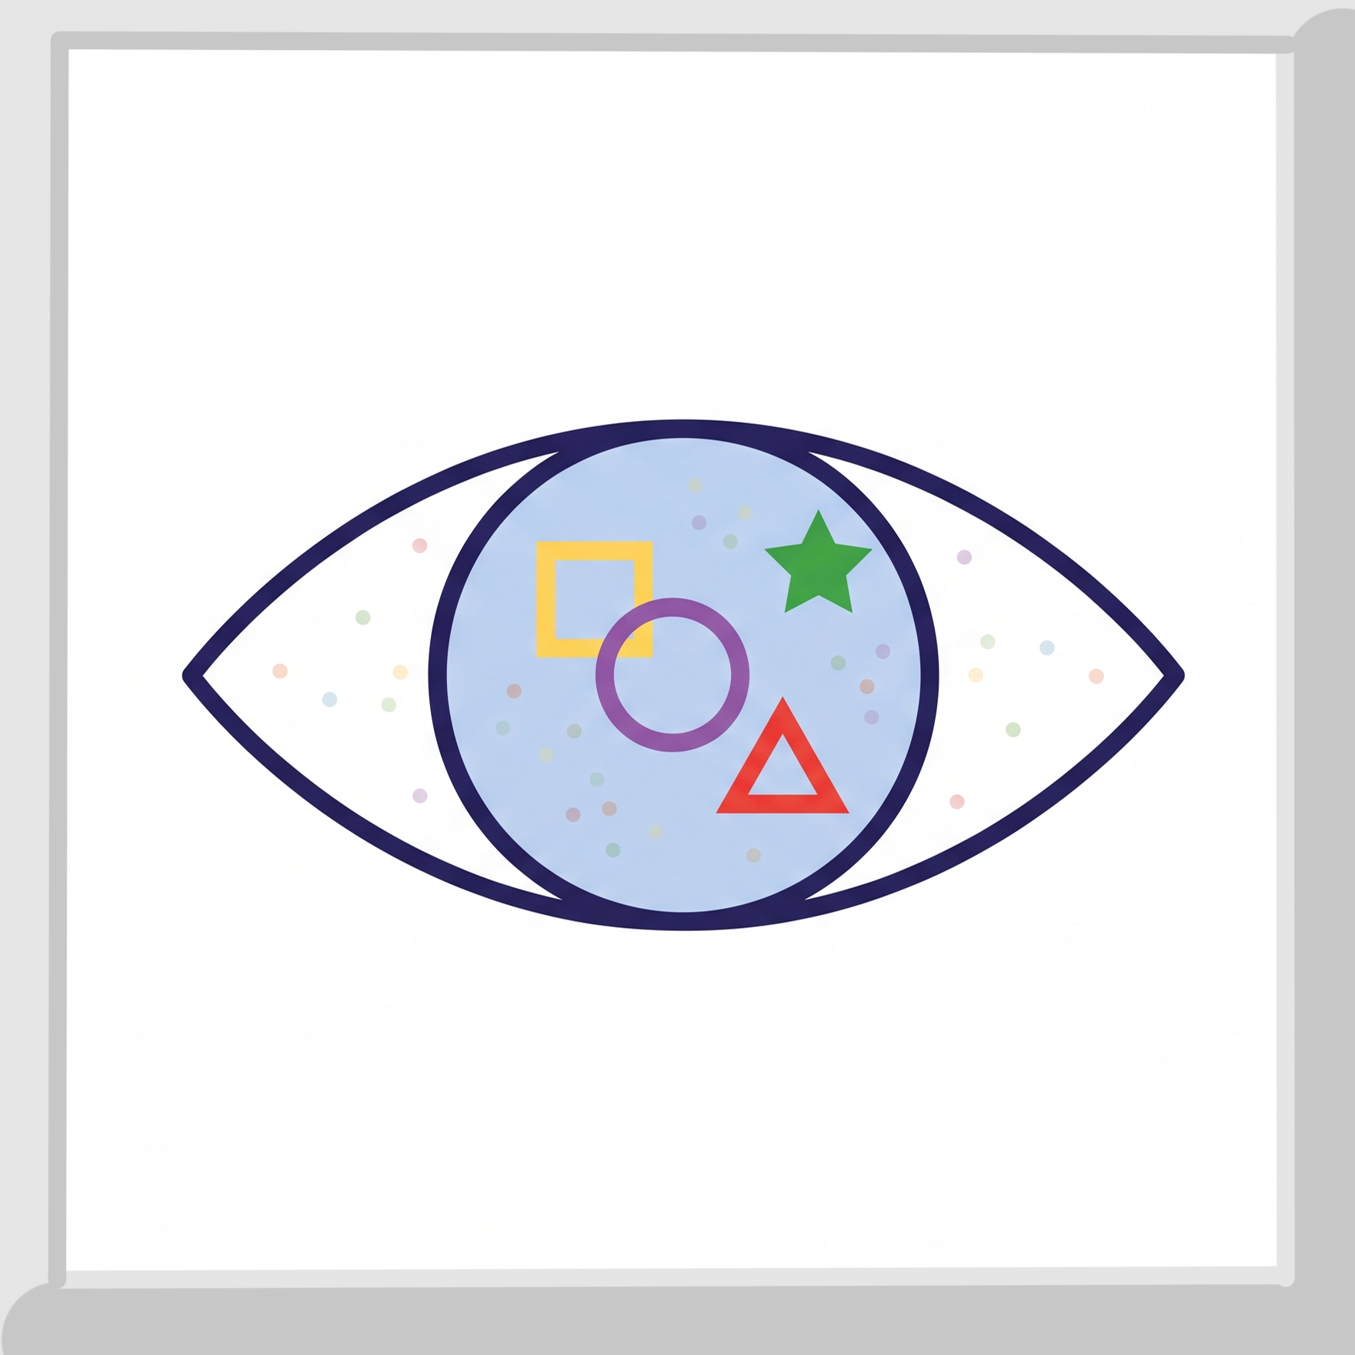
Shape match - color vision tester for toddlers
A game about finding the colored shapes
in a Ishihara background.

Slide 2
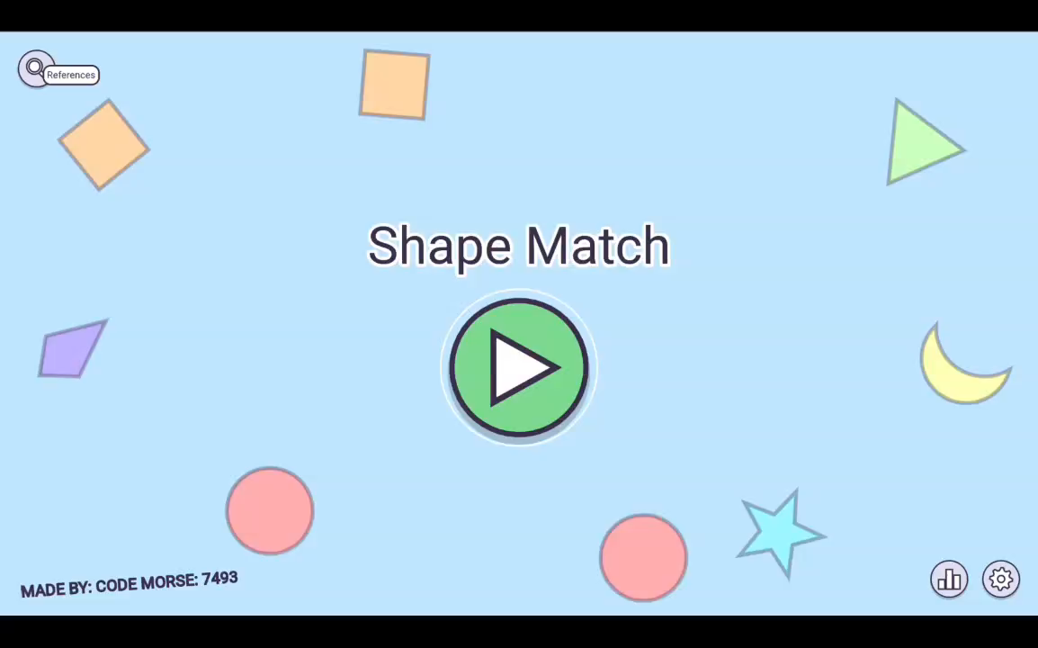
Gamplay and mechanics
Find all the shapes before time runs out

Slide 3
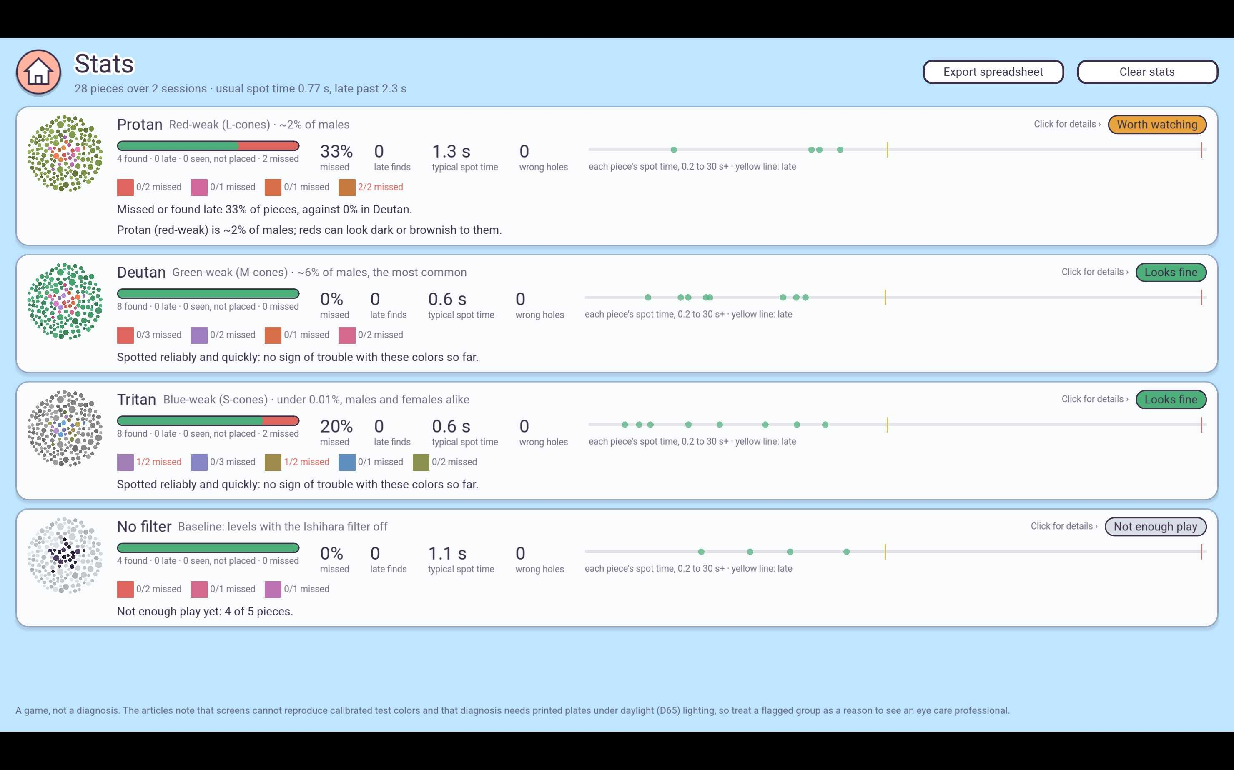
Gather statistics
grouped by the 3 most common types of color blindness

Slide 4
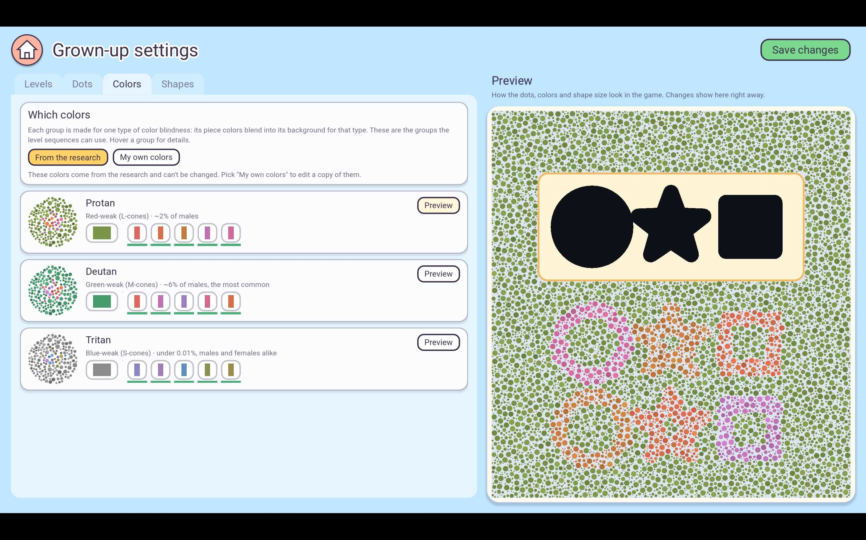
Fully customizable
Make the game fit exactly what you patient needs, specific tests

Slide 5
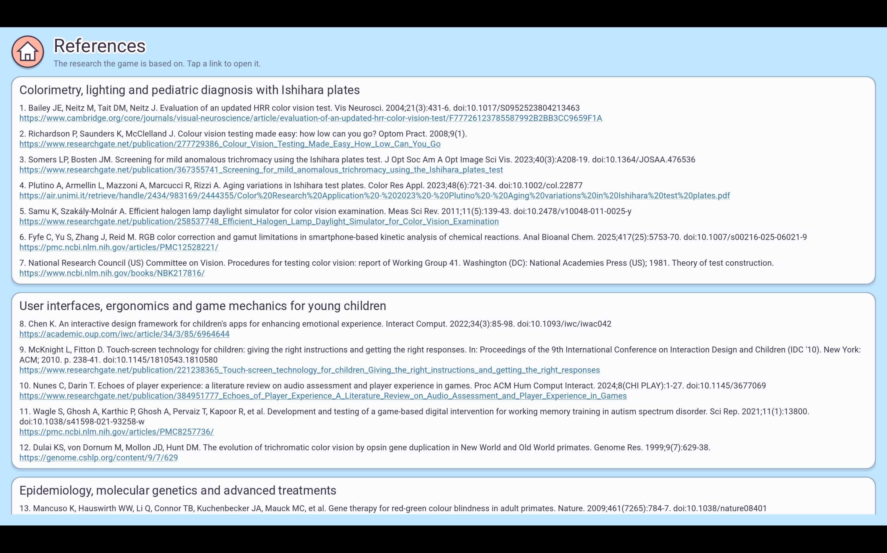
Based on articales and reserch
Ishihara tests data sheets, CVTME, 2-4 old games….. And so on

Slide 6
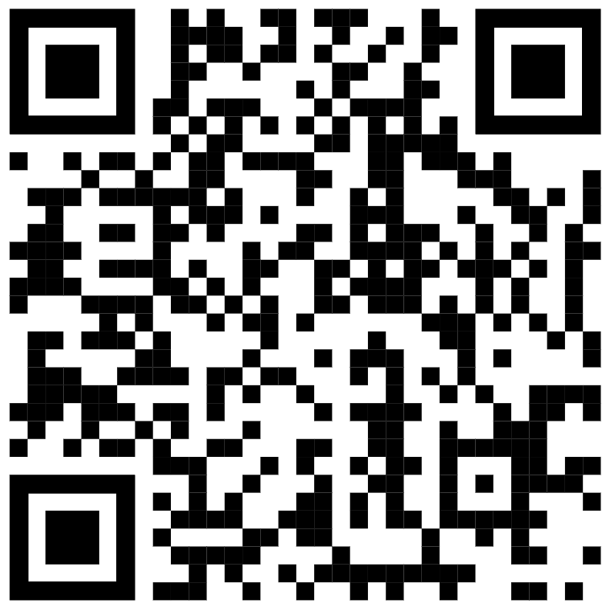
Thank you!
Follow us on Itch and stay tuned!
Itch page

